Slide 1
Parabolas
GSE Pre-Calculus
Keeper 10

Slide 2
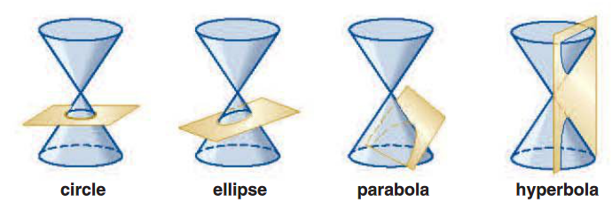
Conic Sections
Conic sections, or conics, are the figures formed when a plane intersects a double-napped right cone. A double-napped cone is two cones opposite each other and extending infinitely upward and downward. The four common conic sections are the parabola, the ellipse, the circle, and the hyperbola.

Slide 3
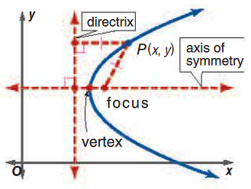
The Parabola
A locus is a set of all points that fulfill a geometric property. A parabola represents the locus of points in a plane that are equidistant from a fixed point, called the focus, and a specific line, called the directrix.
A parabola is symmetric about the line perpendicular to the directrix through the focus called the axis of symmetry. The vertex is the intersection of the parabola and the axis of symmetry.

Slide 4
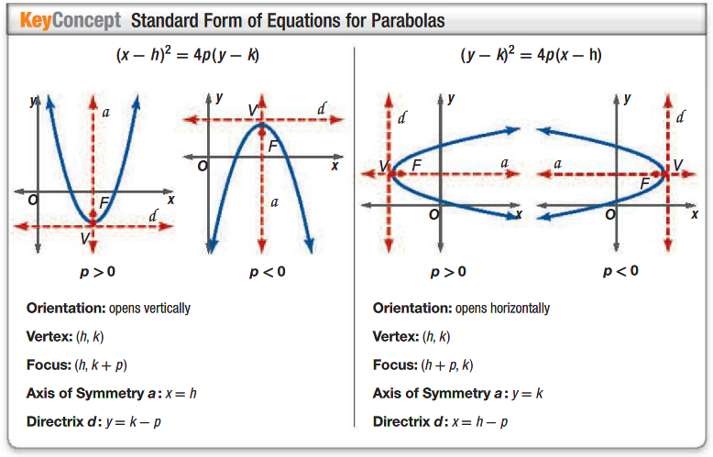
Parabola Equations

Slide 5
Example 1
For ${\left(y+5\right)}^{2}=−12(x−2)$, identify the vertex, focus, axis of symmetry, and directrix. Then graph the parabola.

Slide 6
Example 2
For ${\left(x−2\right)}^{2}=8(y−3)$, identify the vertex, focus, axis of symmetry, and directrix. Then graph the parabola.

Slide 7
Example 3
Write $y^{2}−4y−16x−12=0$in standard form. Identify the vertex, focus, axis of symmetry, and directrix. Then graph the parabola.

Slide 8
Example 4
Write $y=−\frac{1}{4}x^{2}+3x+6$ in standard form. Identify the vertex, focus, axis of symmetry, and directrix. Then graph the parabola.

Slide 9
Example 5
Write an equation for and graph a parabola with the given characteristics.
Focus $(3,−4)$ and vertex $\left(1,−4\right)$
Vertex $(−2,4)$ and directrix $y=1$
Focus $(2,1)$, opens left, and contains the point $(2,5)$

Slide 10
Check for Understanding
For each equation, identify the vertex, focus, axis of symmetry, and directrix. Then graph the parabola.
$8\left(y+3\right)={\left(x−4\right)}^{2}$
$2\left(x+6\right)={\left(y+1\right)}^{2}$
Write each equation in standard form. Identify the vertex, focus, axis of symmetry, and directrix. Then graph the parabola.
$x^{2}−4y+3=7$
$3y^{2}+6y+15=12x$
Write an equation for and graph a parabola with the given characteristics.
Focus $(−6,2)$, vertex $(−6,−1)$
Focus $(5,−2)$, vertex $(9,−2)$
Focus $(−3,−4)$, opens down, contains $(5,−1)$
Focus $(−1,5)$, opens right, contains $(8,−7)$

